Slide 1


Team:Kanoha
Shangirov Yernur(24-P) 220103273,
Parman Bekarys(23-P) 220103284,
Saidulla Ramazan(24-P) 220103054.

Slide 2

Online shop

Slide 3

Formulation of the problem
1
Solving problems with time and money.
2
Identification of discounted products.
3
Helping users search for clothes efficiently.
4
Identification of discounted products.

Slide 4
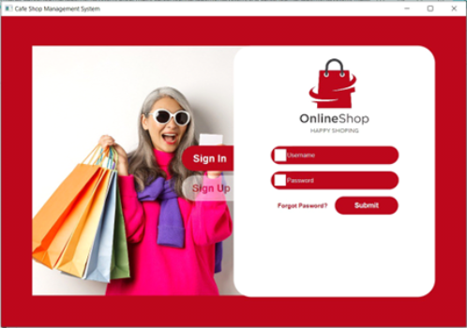
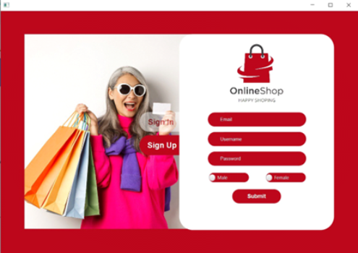
Sign in and Sign up pages
Loading...

Slide 5
Project 3 parts A B C
A. Two-way input system
Administrator interface for selling goods.
Customer interface for purchasing clothes.

Slide 6
B. Admin Interface (Selling Products)
1. Database - Singleton:
For only one database not more than one databases
2. Registration page
Collecting information about the user (name, email, password).
3. Product placement page
Allows administrators to add, update or delete products.
Activation option to change product prices.(Update)
Displays a table of available products.

Slide 7
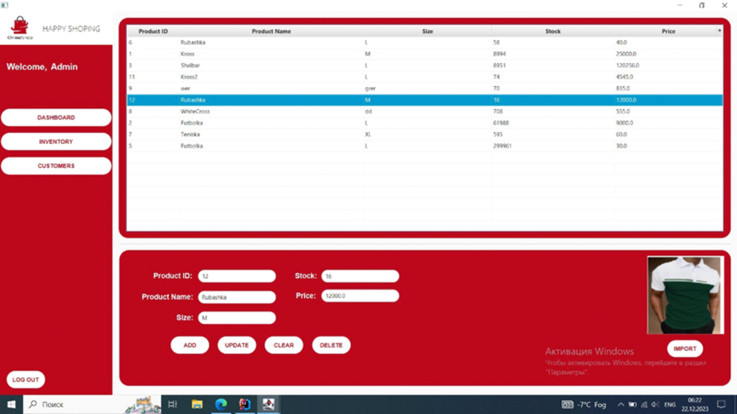

Slide 8
C. Customer Interface (Clothing Shopping)
1. Product selection page
Users can browse and select clothes.
Payment page
2. Payment page - Strategy Pattern:
Applying different strategies to process different types of payment (e.g. PayPal and credit cards).
3. Notification - Observer Pattern:
Notifying users about changes in the cost or availability of goods.
4. Facede pattern used for structure of customer page.

Slide 9
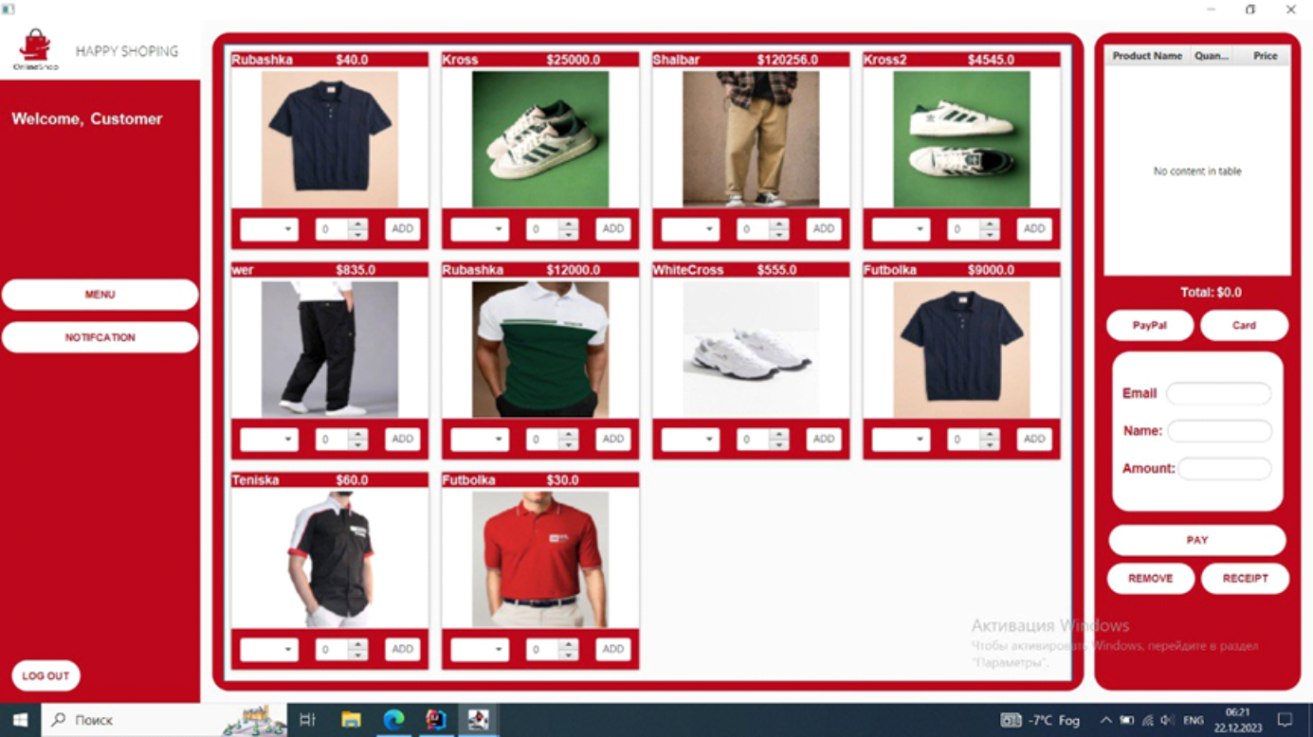

Slide 10
Conclusion
Design and user experience
Comfortable and easy to understand design. Red color theme for visual comfort. Minimalistic design without unnecessary elements.

